Slide 1
Support Vector Machine

Slide 2
Support Vector Machine
A very famous model in Machine Learning, can be applied to both classification and regression
Not only famous but also very powerful; its performance may rival and even surpass the newer deep learning models in some cases
We will discuss SVM for both classification and regression. We begin with the simplest case of linear SVM binary classification

Slide 3
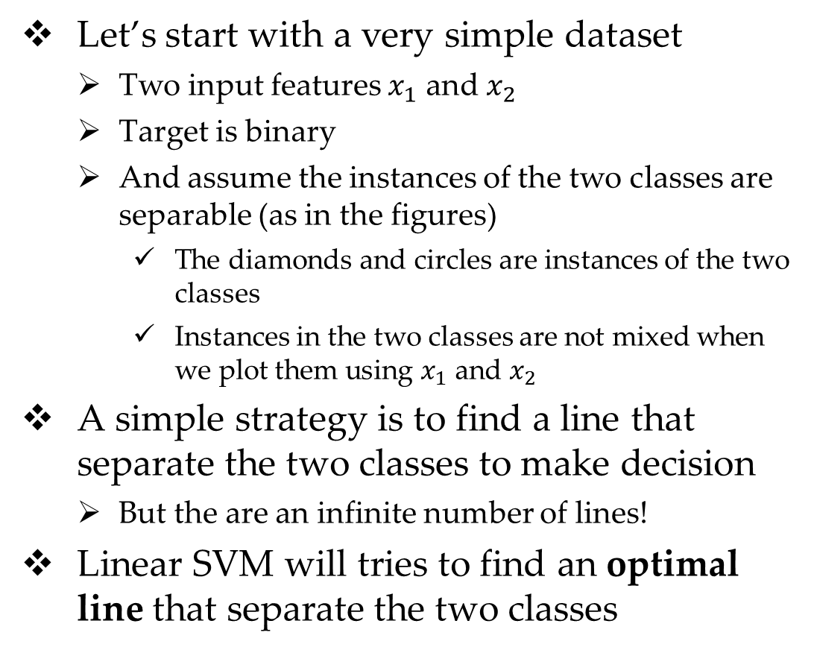
Linear SVM for Binary Classification
Let’s start with a very simple dataset
Two input features $x_{1}$ and $x_{2}$
Target is binary
And assume the instances of the two classes are separable (as in the figures)
The diamonds and circles are instances of the two classes
Instances in the two classes are not mixed when we plot them using $x_{1}$ and $x_{2}$
A simple strategy is to find a line that separate the two classes to make decision
But the are an infinite number of lines!
Linear SVM will tries to find an optimal line that separate the two classes

Slide 4
The Optimal Line that Separates the Classes
The optimal line that linear SVM found must
Separate the two classes
Maximize the margin between the two classes
Margin means the distances between the boundaries of the two classes
As it turns out, there is only one line that satisfies this condition
So, the solution from SVM is unique
The instances that lie on the boundaries are called Support Vectors, hence the name Support Vector Machine
Boundaries of the class
Maximized!

Slide 5
How to Make Decisions
After having the line, making decision is simple:
Anything under the line belong to one class
Anything above the line belong to the other class
Instances in this region belong to class circle
Instances in this region belong to class diamond

Slide 6
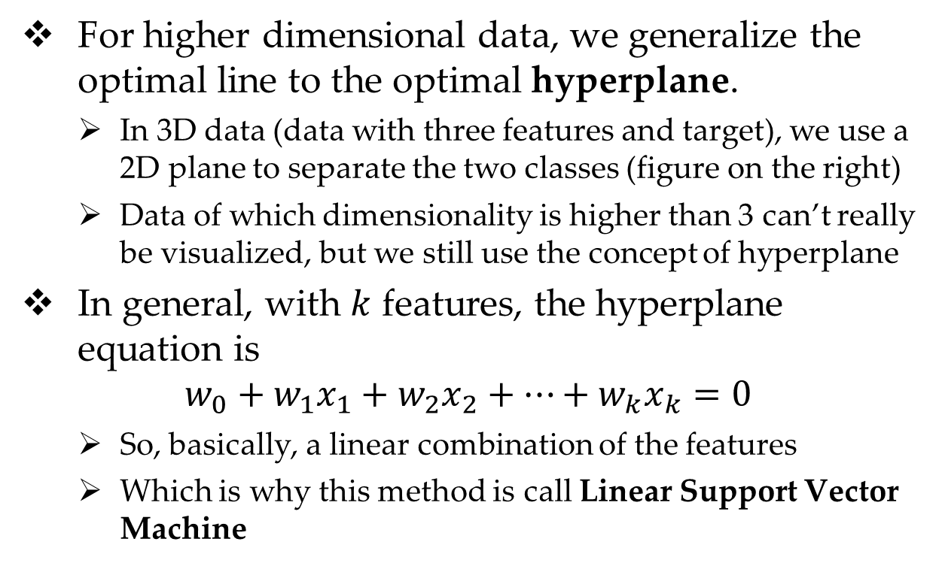
Into Higher Dimensional Data
For higher dimensional data, we generalize the optimal line to the optimal hyperplane.
In 3D data (data with three features and target), we use a 2D plane to separate the two classes (figure on the right)
Data of which dimensionality is higher than 3 can’t really be visualized, but we still use the concept of hyperplane
In general, with $k$ features, the hyperplane equation is
$$w_{0}+w_{1}x_{1}+w_{2}x_{2}+…+w_{k}x_{k}=0$$
So, basically, a linear combination of the features
Which is why this method is call Linear Support Vector Machine

Slide 7
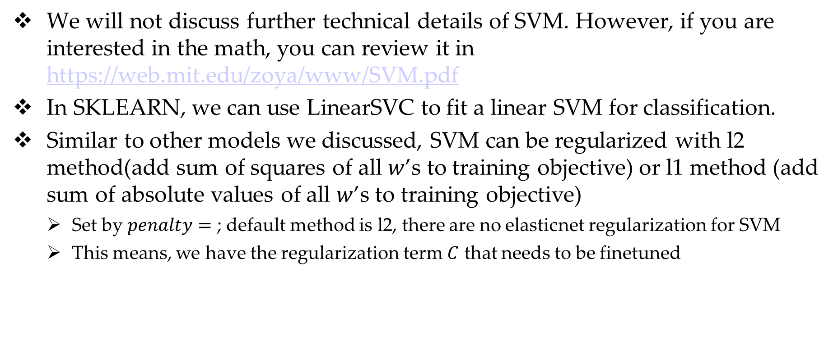
Linear Support Vector Machine in SKLearn
We will not discuss further technical details of SVM. However, if you are interested in the math, you can review it in https://web.mit.edu/zoya/www/SVM.pdf
In SKLEARN, we can use LinearSVC to fit a linear SVM for classification.
Similar to other models we discussed, SVM can be regularized with l2 method(add sum of squares of all $w$’s to training objective) or l1 method (add sum of absolute values of all $w$’s to training objective)
Set by $penalty=$ ; default method is l2, there are no elasticnet regularization for SVM
This means, we have the regularization term $C$ that needs to be finetuned

Slide 8
Non-Linearly Separable Data
The data where instances are nicely distributed we used in the example is called linearly separable
And you can guess, we rarely, if ever, see them in practice
Data from real world are more non-linearly separable – instances of classes are mixed in the same areas
No linear boundary can be found
Linear SVM becomes insufficient
In such cases, we the kernel trick to obtain non-linear SVM
The new model is then called Kernel SVM
Is there any line that can separate the two classes in this case?

Slide 9
The Kernel Trick
Very roughly speaking, the kernel trick means to use something called a kernel function to transform/map data to an implicit higher dimensional space where instances of different classes suppose to be more linearly separable
This means, there are no guarantees that the kernel trick will work
And thus, we need to finetune the kernel functions
Implicit means we don’t actually know that new space to which the kernel function mapped data
Only know the instances’ similarity, represented by the values of the kernel function
Original Space
Kernel Trick
Higher Dimensional Space

Slide 10
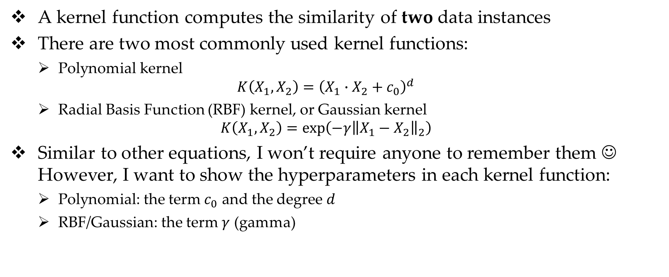
Kernel Functions and Similarity
A kernel function computes the similarity of two data instances
There are two most commonly used kernel functions:
Polynomial kernel
$$K\left(X_{1},X_{2}\right)={\left(X_{1}∙X_{2}+c_{0}\right)}^{d}$$
Radial Basis Function (RBF) kernel, or Gaussian kernel
$$K\left(X_{1},X_{2}\right)=\exp\left(−γ{\left\|X_{1}−X_{2}\right\|}_{2}\right)$$
Similar to other equations, I won’t require anyone to remember them ☺ However, I want to show the hyperparameters in each kernel function:
Polynomial: the term $c_{0}$ and the degree $d$
RBF/Gaussian: the term $γ$ (gamma)

Slide 11
In SKLearn
For kernel SVM, we use SVC instead of LinearSVC
There are a few hyperparameters as mentioned:
kernel – ‘poly’ for Polynomial, ‘rbf’ for RBF/Gaussian
coef0 and degree for Polynomial kernel
gamma for RBF/Gaussian
And of course, C for regularization. We do not have l1 regularization in kernel SVM

Slide 12
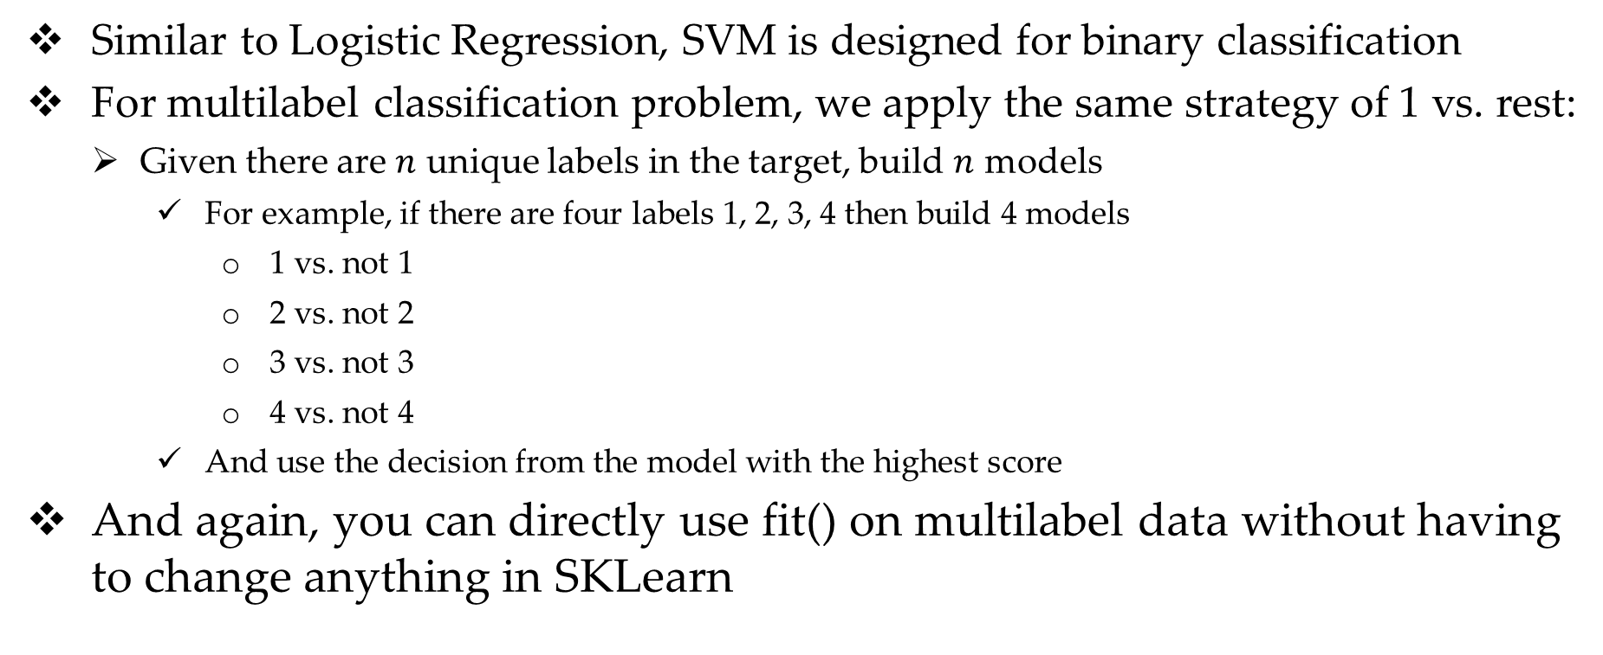
SVM for Multilabel Classification
Similar to Logistic Regression, SVM is designed for binary classification
For multilabel classification problem, we apply the same strategy of 1 vs. rest:
Given there are $n$ unique labels in the target, build $n$ models
For example, if there are four labels 1, 2, 3, 4 then build 4 models
1 vs. not 1
2 vs. not 2
3 vs. not 3
4 vs. not 4
And use the decision from the model with the highest score
And again, you can directly use fit() on multilabel data without having to change anything in SKLearn

Slide 13
SVR – SVM for Regression
Also called Support Vector Regression (SVR)
SVM can be modified to work on regression problems
In regression, SVR find a hyperplane that minimize the margin of data – distance between the two boundaries of the instances in this case
Instances lying on the boundaries are still called Support Vectors
Target
Input Feature
Minimized!

Slide 14
Kernel Trick in SVR
Also used to map data to an implicit higher dimensional space where data is better distributed
Kernel Trick
Original Space
High-Dimensional Space

Slide 15
SVR In SKLearn
We use SVR class
All hyperparameters are similar to SVC:
kernel – ‘poly’ for Polynomial, ‘rbf’ for RBF/Gaussian
coef0 and degree for Polynomial kernel
gamma for RBF/Gaussian
And of course, C for regularization. Again, we do not have l1 regularization in kernel SVM

Slide 16
Advantages of SVM (both SVC and SVR)
Solution is optimal and unique
Effective in high dimensional spaces.
Still effective in cases where number of dimensions is greater than the number of samples.
Uses a subset of training points in the decision function (called support vectors), so it is also memory efficient.
Automatically handles non-linearities without users having to create/engineer new features (like log, polynomial, interactions…)

Slide 17
Disadvantages
High complexity, finetuning SVMs in datasets of ten of thousand instances is not recommended
If the number of features is much greater than the number of samples, avoid over-fitting in choosing kernel functions and regularization terms is crucial.

